Slide 1


Presenter Name’s:
Rashmika Gaddam:(007814073)
Likhitha Reddy Eddala:(007758407)
Saranya Valleri: (007760981)
Poojitha Gutha:(007813930)

Slide 2


Agenda
Online voting system
Online voting system helps people to cast their vote through online without going to polling booth and standing in long queue to cast their vote.It was challenging for the government to motivate the public to participate in the election and cast their vote as there are no such online voting system available.

Slide 3
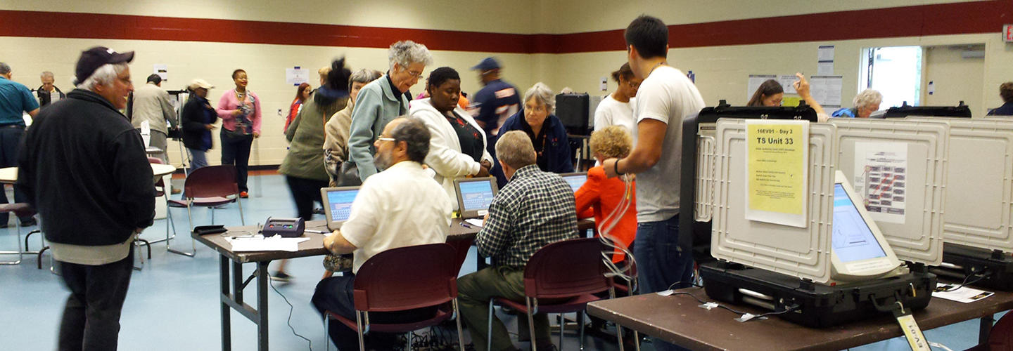


Introduction
The voting server collects the votes and filters out duplicate and invalid votes. Each voter can then check her/his vote online to ensure that her vote has been counted correctly. This case study concerns a simplified system of the online voting system. The online voting system allows the voter at any place to vote. It also provides the specific time to vote. It stores the party symbols according to each party and count the result based on party symbols

Slide 4

UML Diagram:
Use Case Diagram
Sequence diagram
Collaboration Diagram
Class Diagram

Slide 5


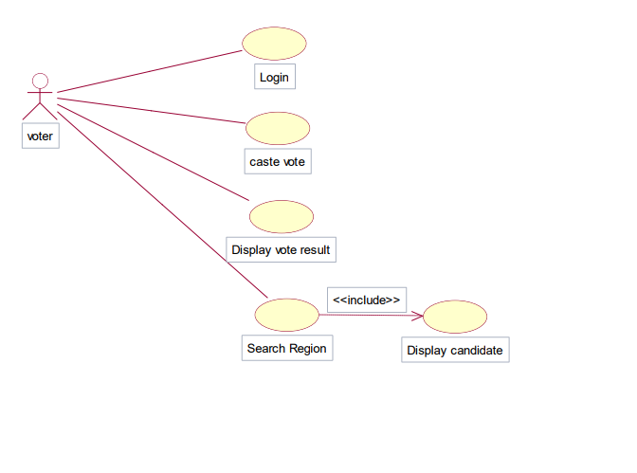
USECASE DIAGRAM FOR VOTER

Slide 6
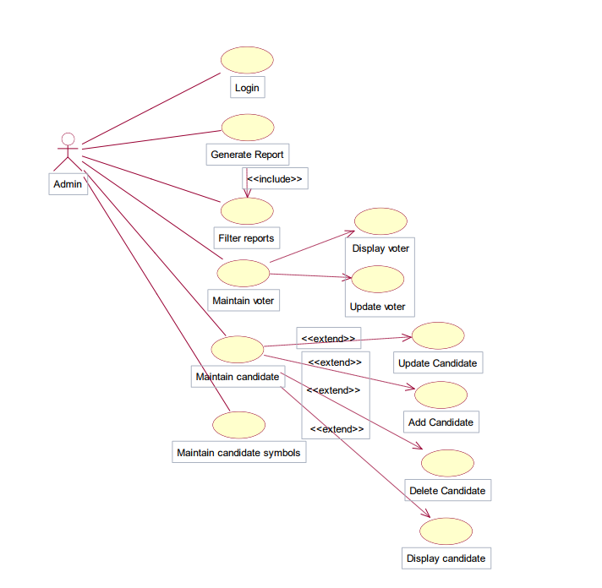

USECASE DIAGRAM FOR ADMINISTRATOR

Slide 7
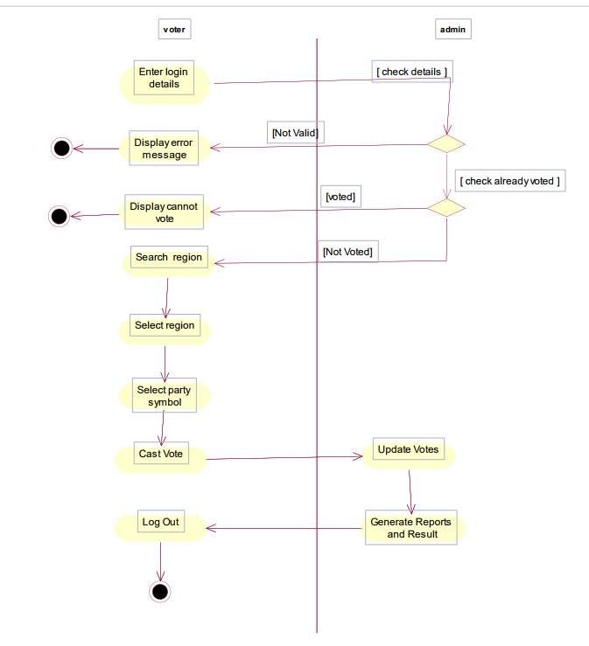

ACTIVITY DIAGRAM
ACTIVITY DIAGRAM FOR ONLINE VOTING SYSTEM:

Slide 8
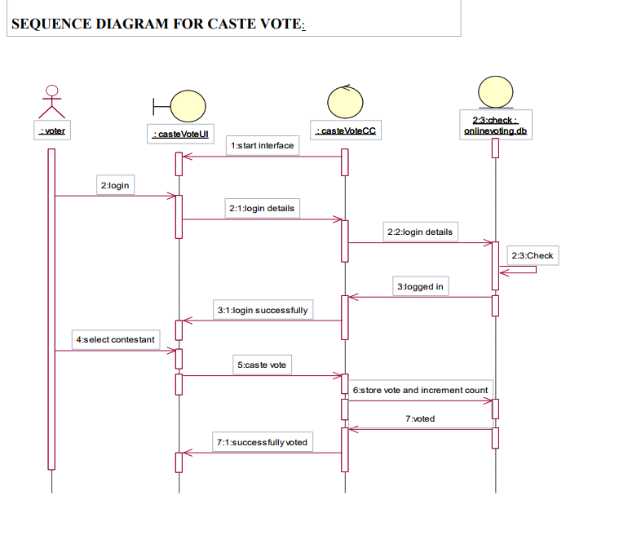

SEQUENCE DIAGRAM

Slide 9
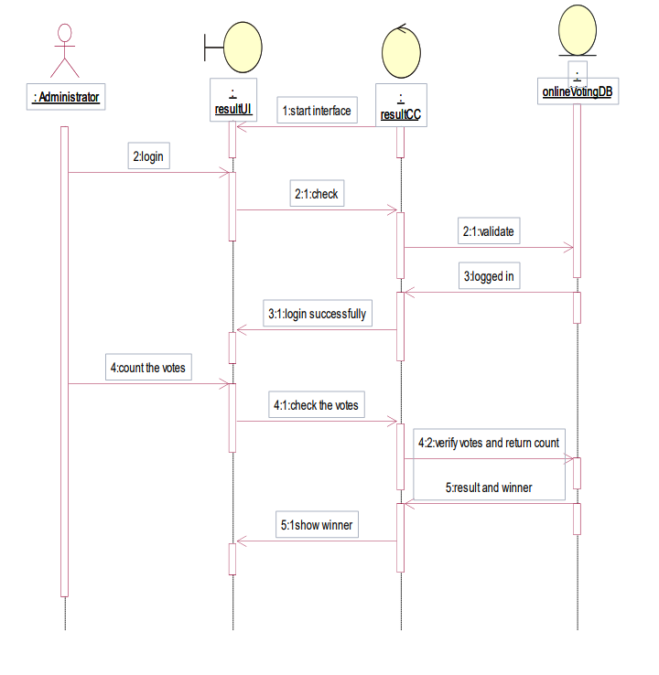
SEQUENCE DIAGRAM FOR DISPLAY RESULT

Slide 10
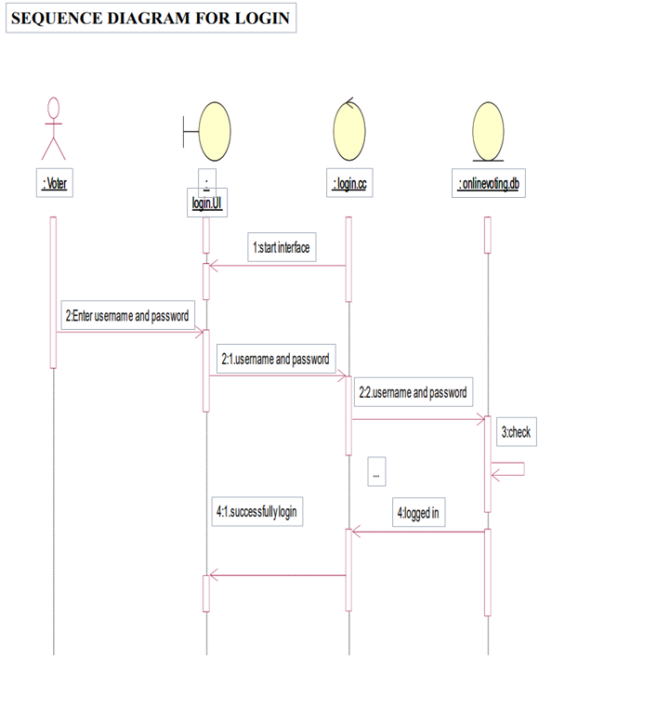


Slide 11
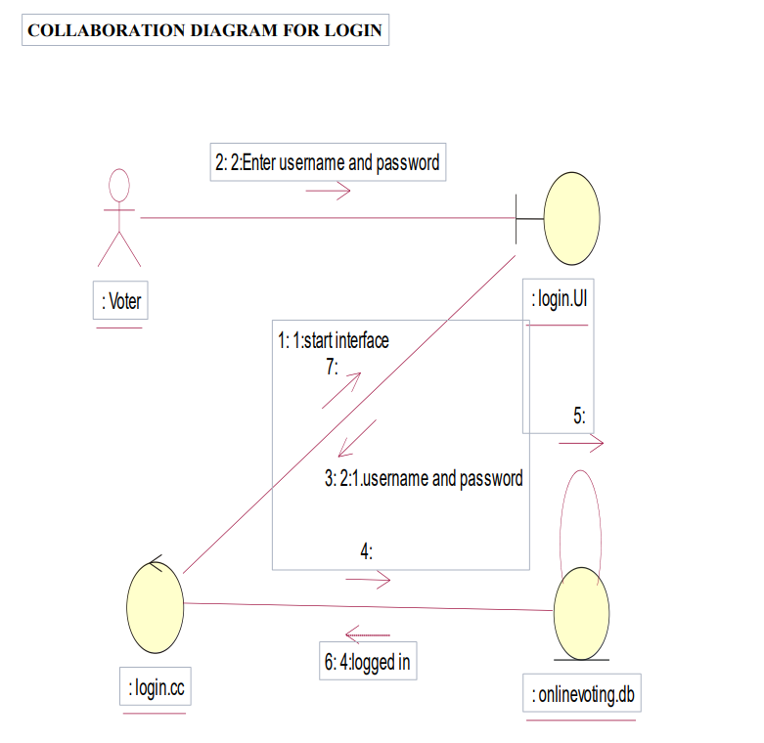
COLLABORATION DIAGRAM FOR ONLINE VOTING SYSTEM

Slide 12
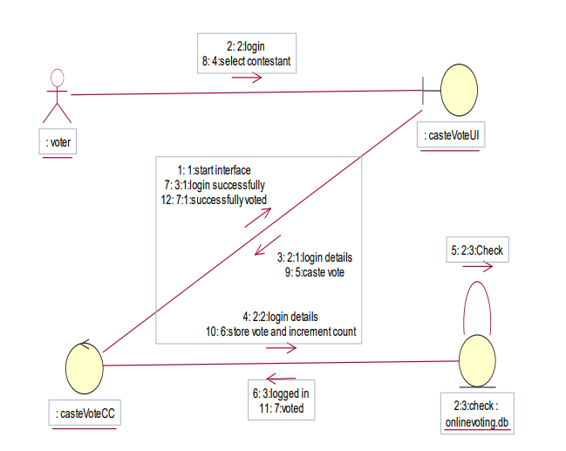
COLLABORATION DIAGRAM FOR CASTE VOTE

Slide 13
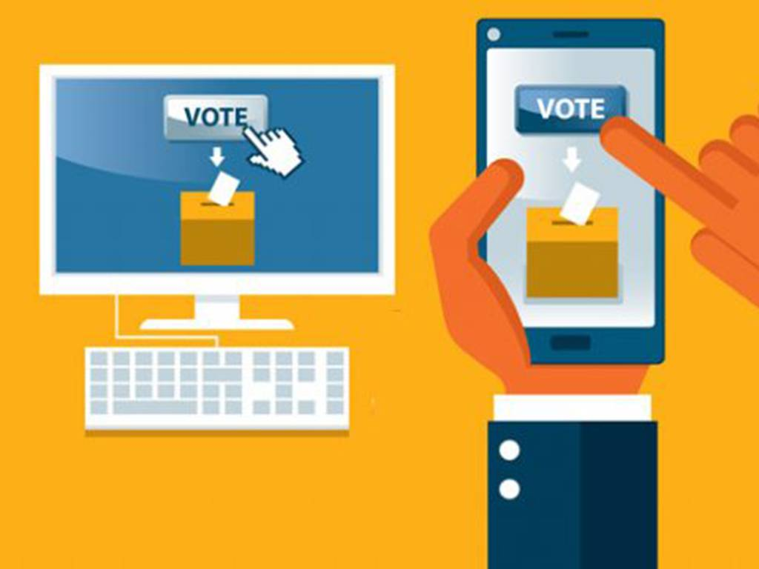
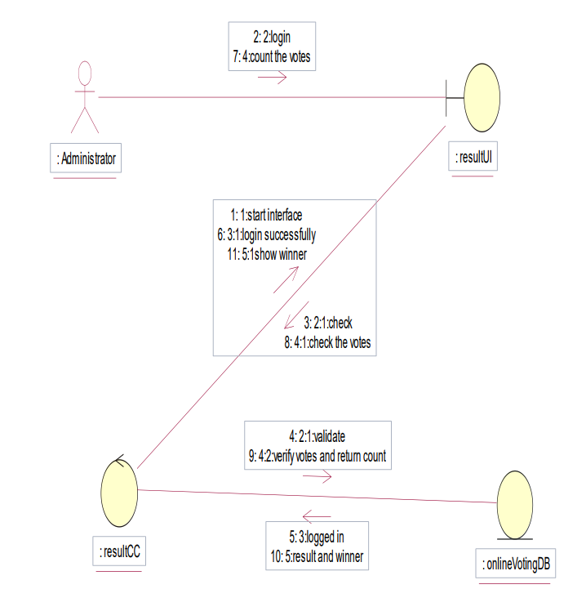
COLLABORATION DIAGRAM FOR DISPLAY RESULT

Slide 14
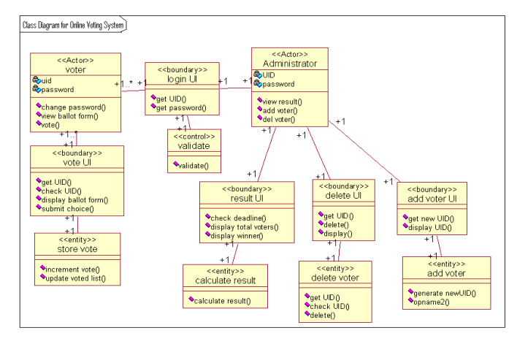
CLASS DIAGRAM FOR ONLINE VOTING SYSTEM

Slide 15
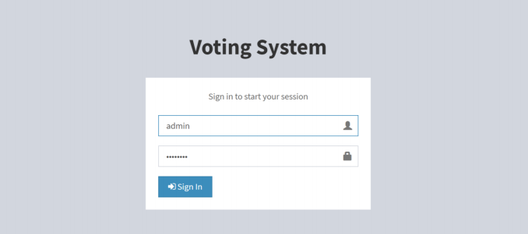
Admin login:

Slide 16
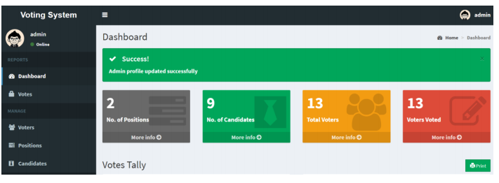
Admin Dashboard:

Slide 17

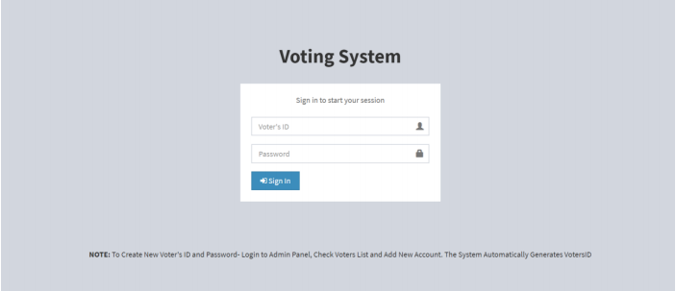
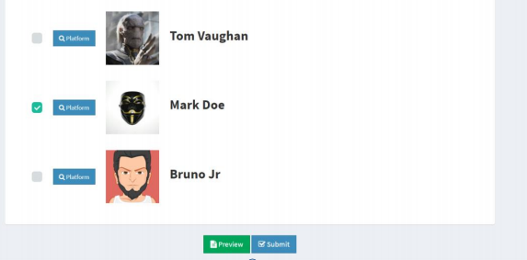
User Login:
Caste Vote :

Slide 18
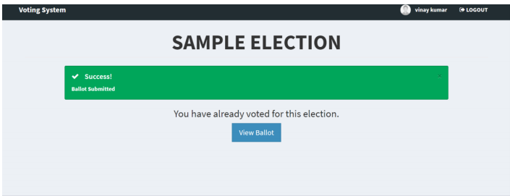
Confirmation:

Slide 19
SOFTWARE REQUIREMENTS:
Technology :Java, HTML, CSS, JavaScript, ApacheWicket, Sring, SpringBoot, Microservices, MSsql, mangoDB.
Model: Agile Scrum.
Tools : Jira, GitHub, SOAP UI, Postman, IntelliJ.

Slide 20

Summary
Electronic voting technology intends to speed the counting of ballots, reduce the cost of paying staff to count votes manually and can provide improved accessibility for disabled voters. Also in the long term, expenses are expected to decrease. Results can be reported and published faster

Slide 21


Thank You

